Slide 1
SOME EARLY LESSONS OF THE PANDEMIC
SANJAY G. REDDY

Slide 6
Covid-19 prevalence and GDP per capita growth by region
WHO Region | Cumulative cases per million | Cumulative deaths per million | GDP per capita growth, 2020
Americas | 42045.7 | 966.2 | -6.3%
Europe | 32032.2 | 683.7 | -6.9%
Eastern Mediterranean | 7686.9 | 185.5 | -6.8%
South-East Asia | 6296.0 | 96.6 | -8.2%
Africa | 2154.9 | 50.9 | -5.7%
Western Pacific | 673.7 | 11.7 | -0.7%

Slide 7
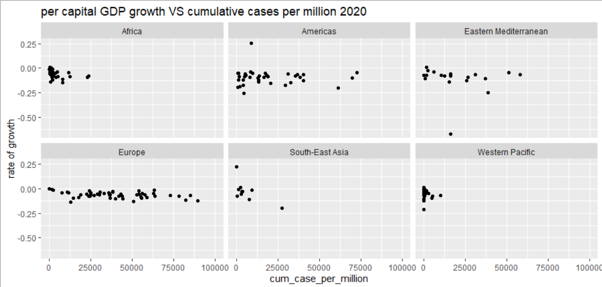

Slide 8
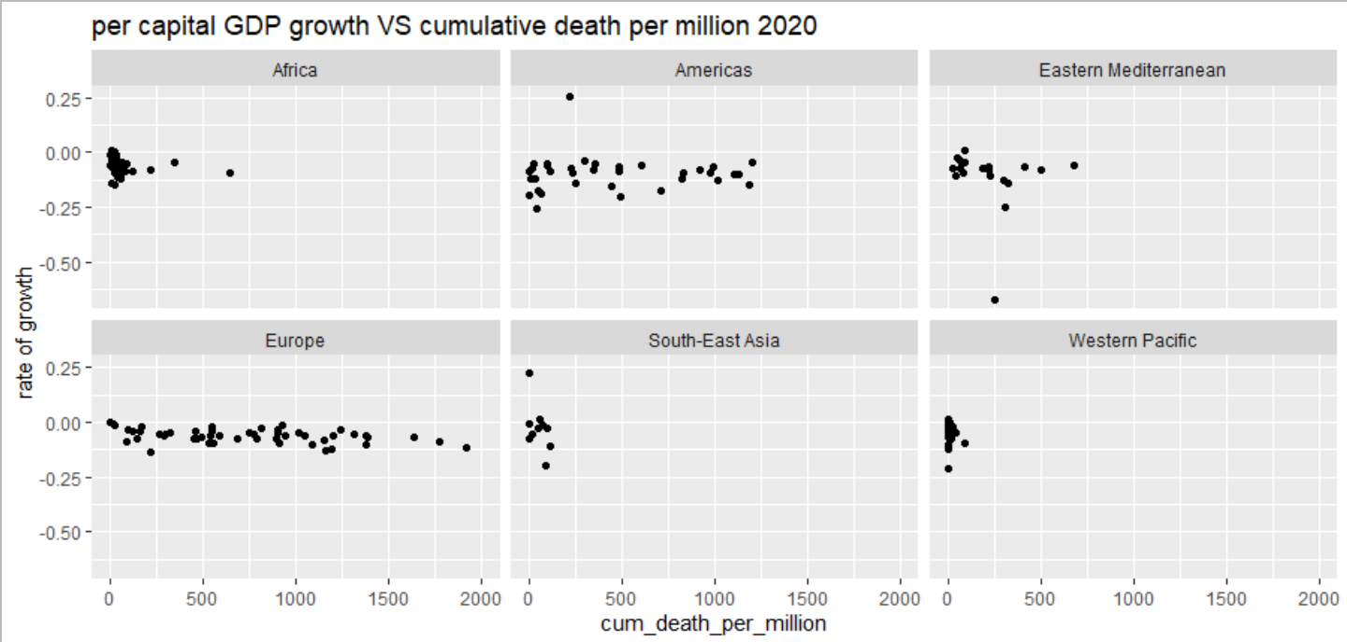

Slide 9
ACT STRATEGICALLY

Slide 10
INdia

Slide 11
ANTICIPATE
and integrate

Slide 12
Protect
Before it is necessary

Slide 13
Build trust

Slide 14
Not all Constraints are equal

Slide 15
Learn to learn

Slide 16
COOPERATion deficits ARE costLY

